Slide 1
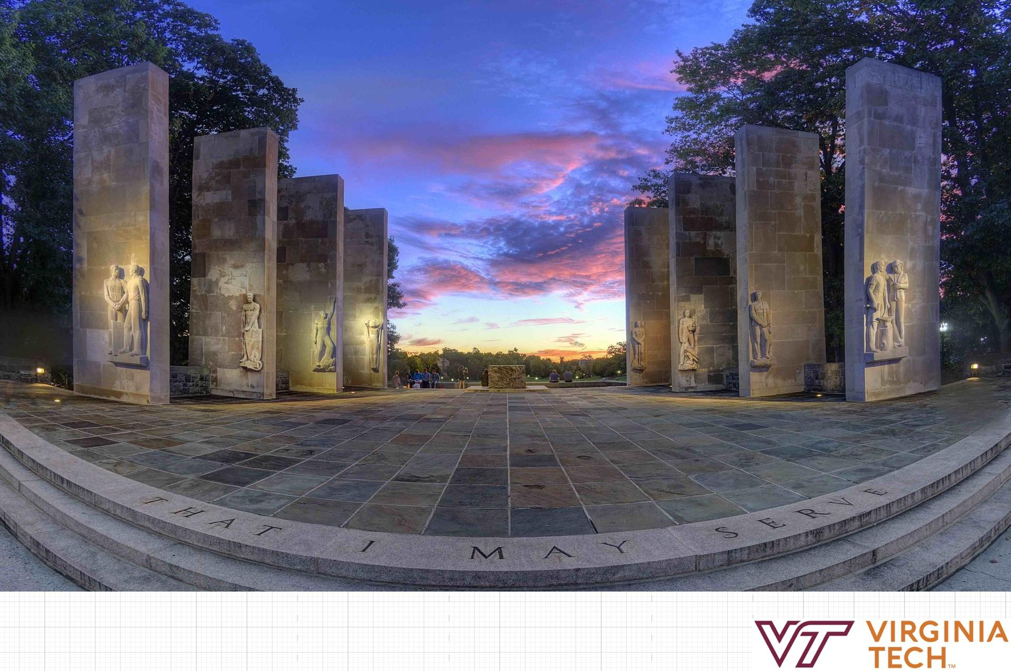
Immersive Reality Travel
Mobile Mixed Reality-Prototype & Evaluation
Wenjun Han, Gram Hsing, Harsh Sanghavi, Tianzi Wang
Notes:
: Good afternoon everyone! We are mobile platform research group, I am ……

Slide 2
Project Goal
Our Team’s goal
To determine whether the inclusion of a mixed reality (XR) experience
Into undergraduate recruitment lifecycle improves enrollment into VT
Identify possible avenues of incorporating XR into a “mobile” platform
Understand user needs & system requirements
Design the system and evaluate its usefulness

Slide 3
Planning, Scoping, and Definition
Literature Review
Understand current research on mobile AR, AR in tourism and AR applications as a whole
Focus Groups
Understand our potential user base, see what makes them tick

Slide 4
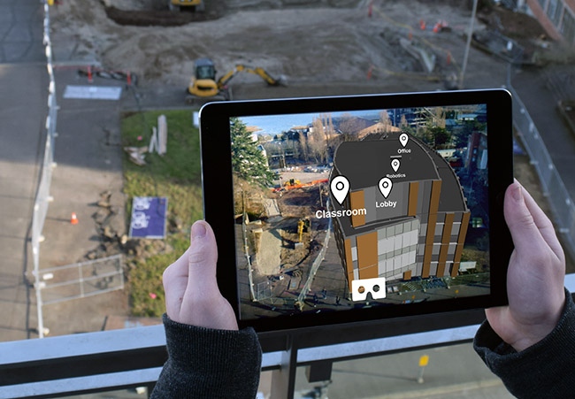
Planning, Scoping, and Definition

Slide 5
Exploration, Synthesis and Design Implications
Stakeholder Interviews
Understand the system requirements
Match the correct requirements with the right user needs
User Interviews
Test our design ideas on users
Understand what they want to see

Slide 6
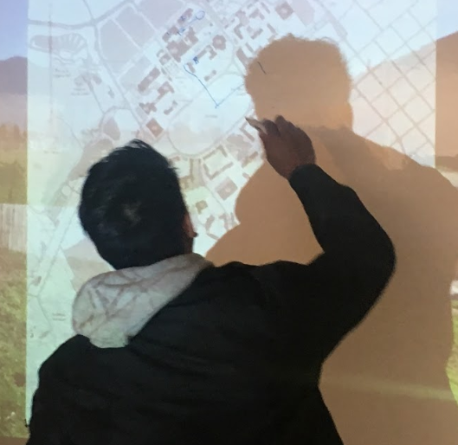
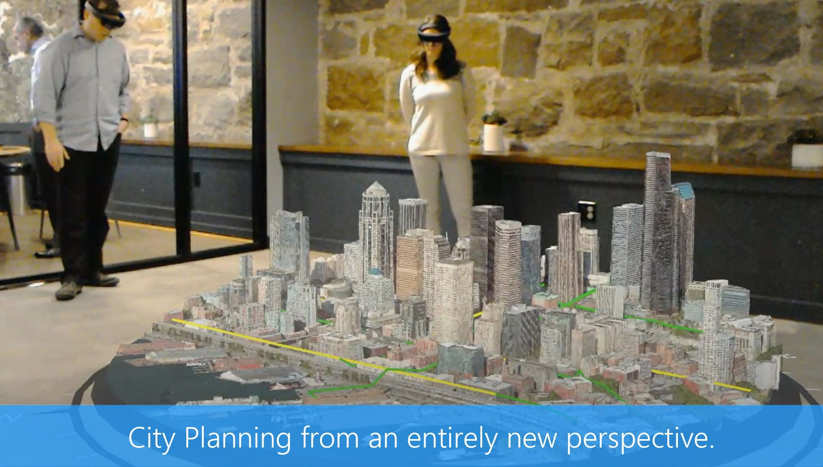
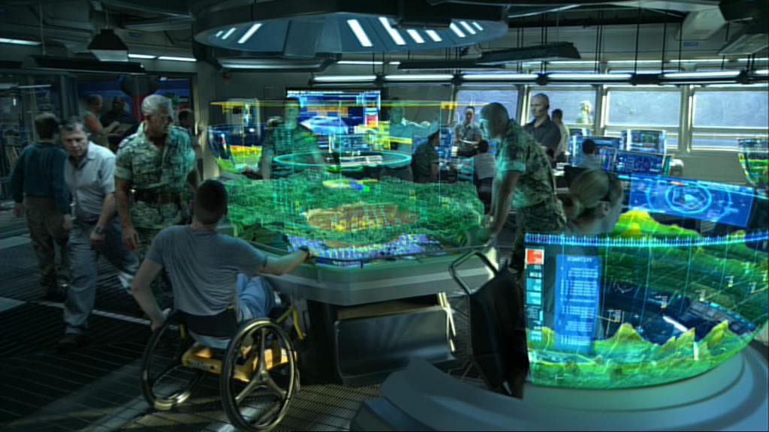
Exploration, Synthesis and Design Implications

Slide 7
Concept Generation & Early Prototyping
Storyboarding
Understand where our design could best help attract students
Design our experience with the user in mind
Design Charrettes
Start the early prototyping of our interface

Slide 8
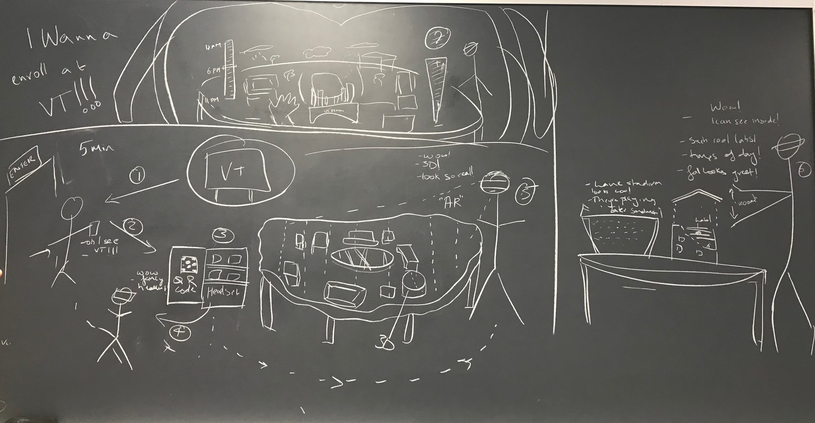
Concept Generation & Early Prototyping
Environment
Display
Content
Interactions
Outcome

Slide 9
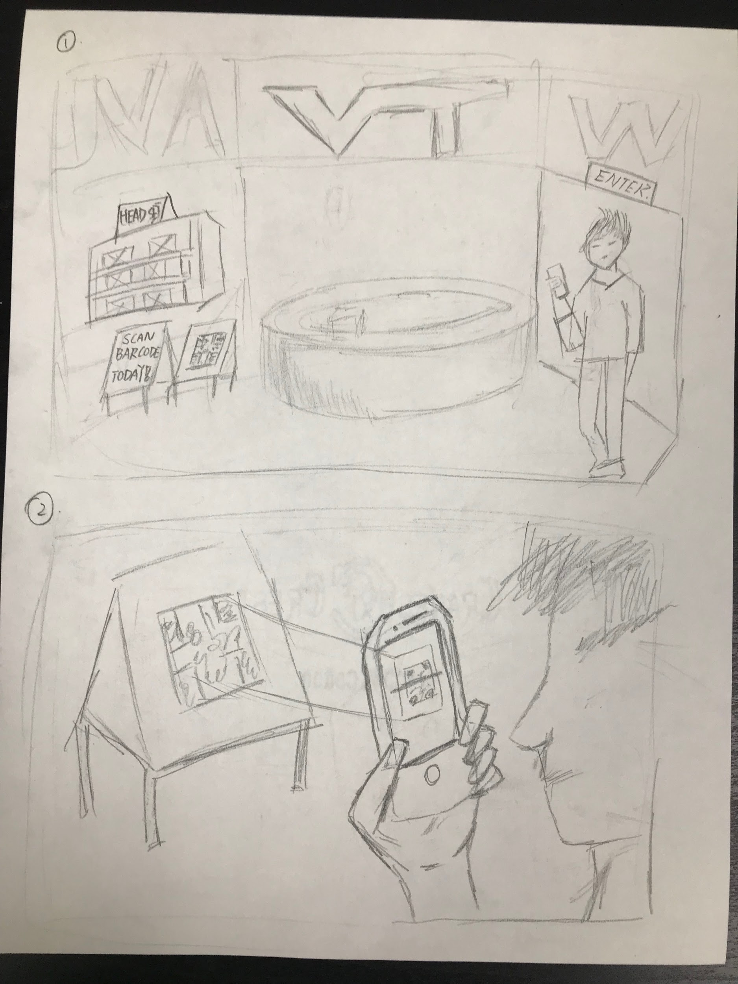
Concept Generation & Early Prototyping

Slide 10
Concept Generation & Early Prototyping

Slide 11
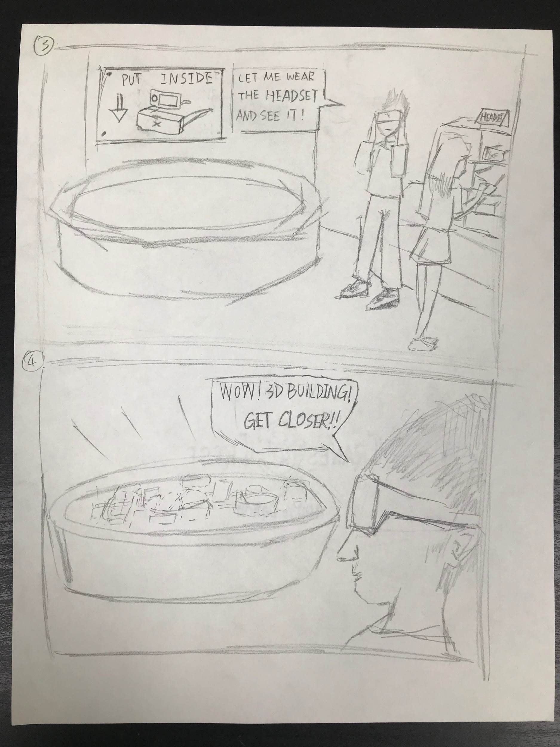
Concept Generation & Early Prototyping

Slide 12
Concept Generation & Early Prototyping

Slide 13
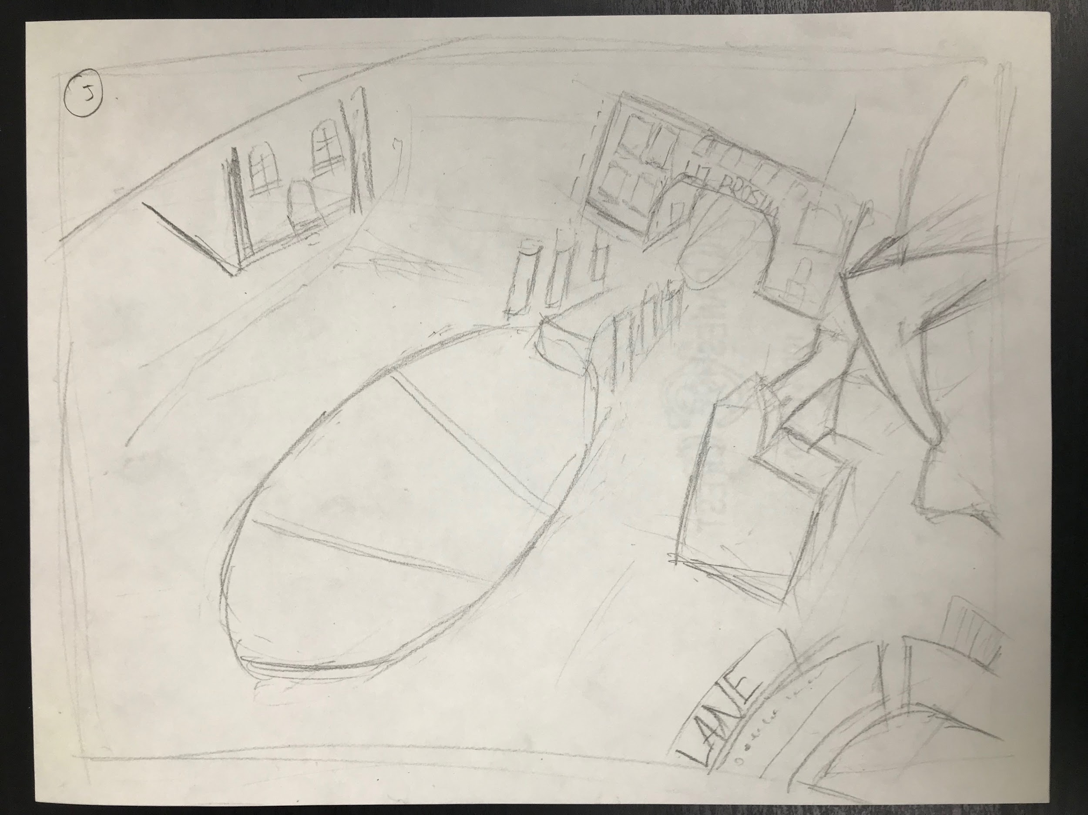
Concept Generation & Early Prototyping

Slide 14
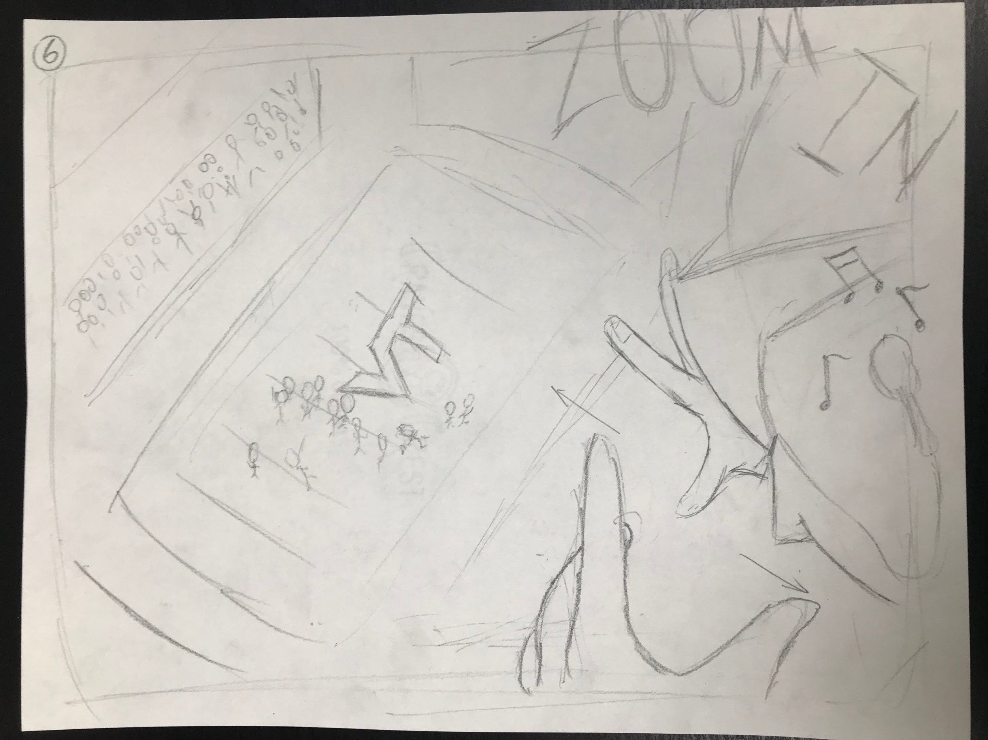
Concept Generation & Early Prototyping

Slide 15
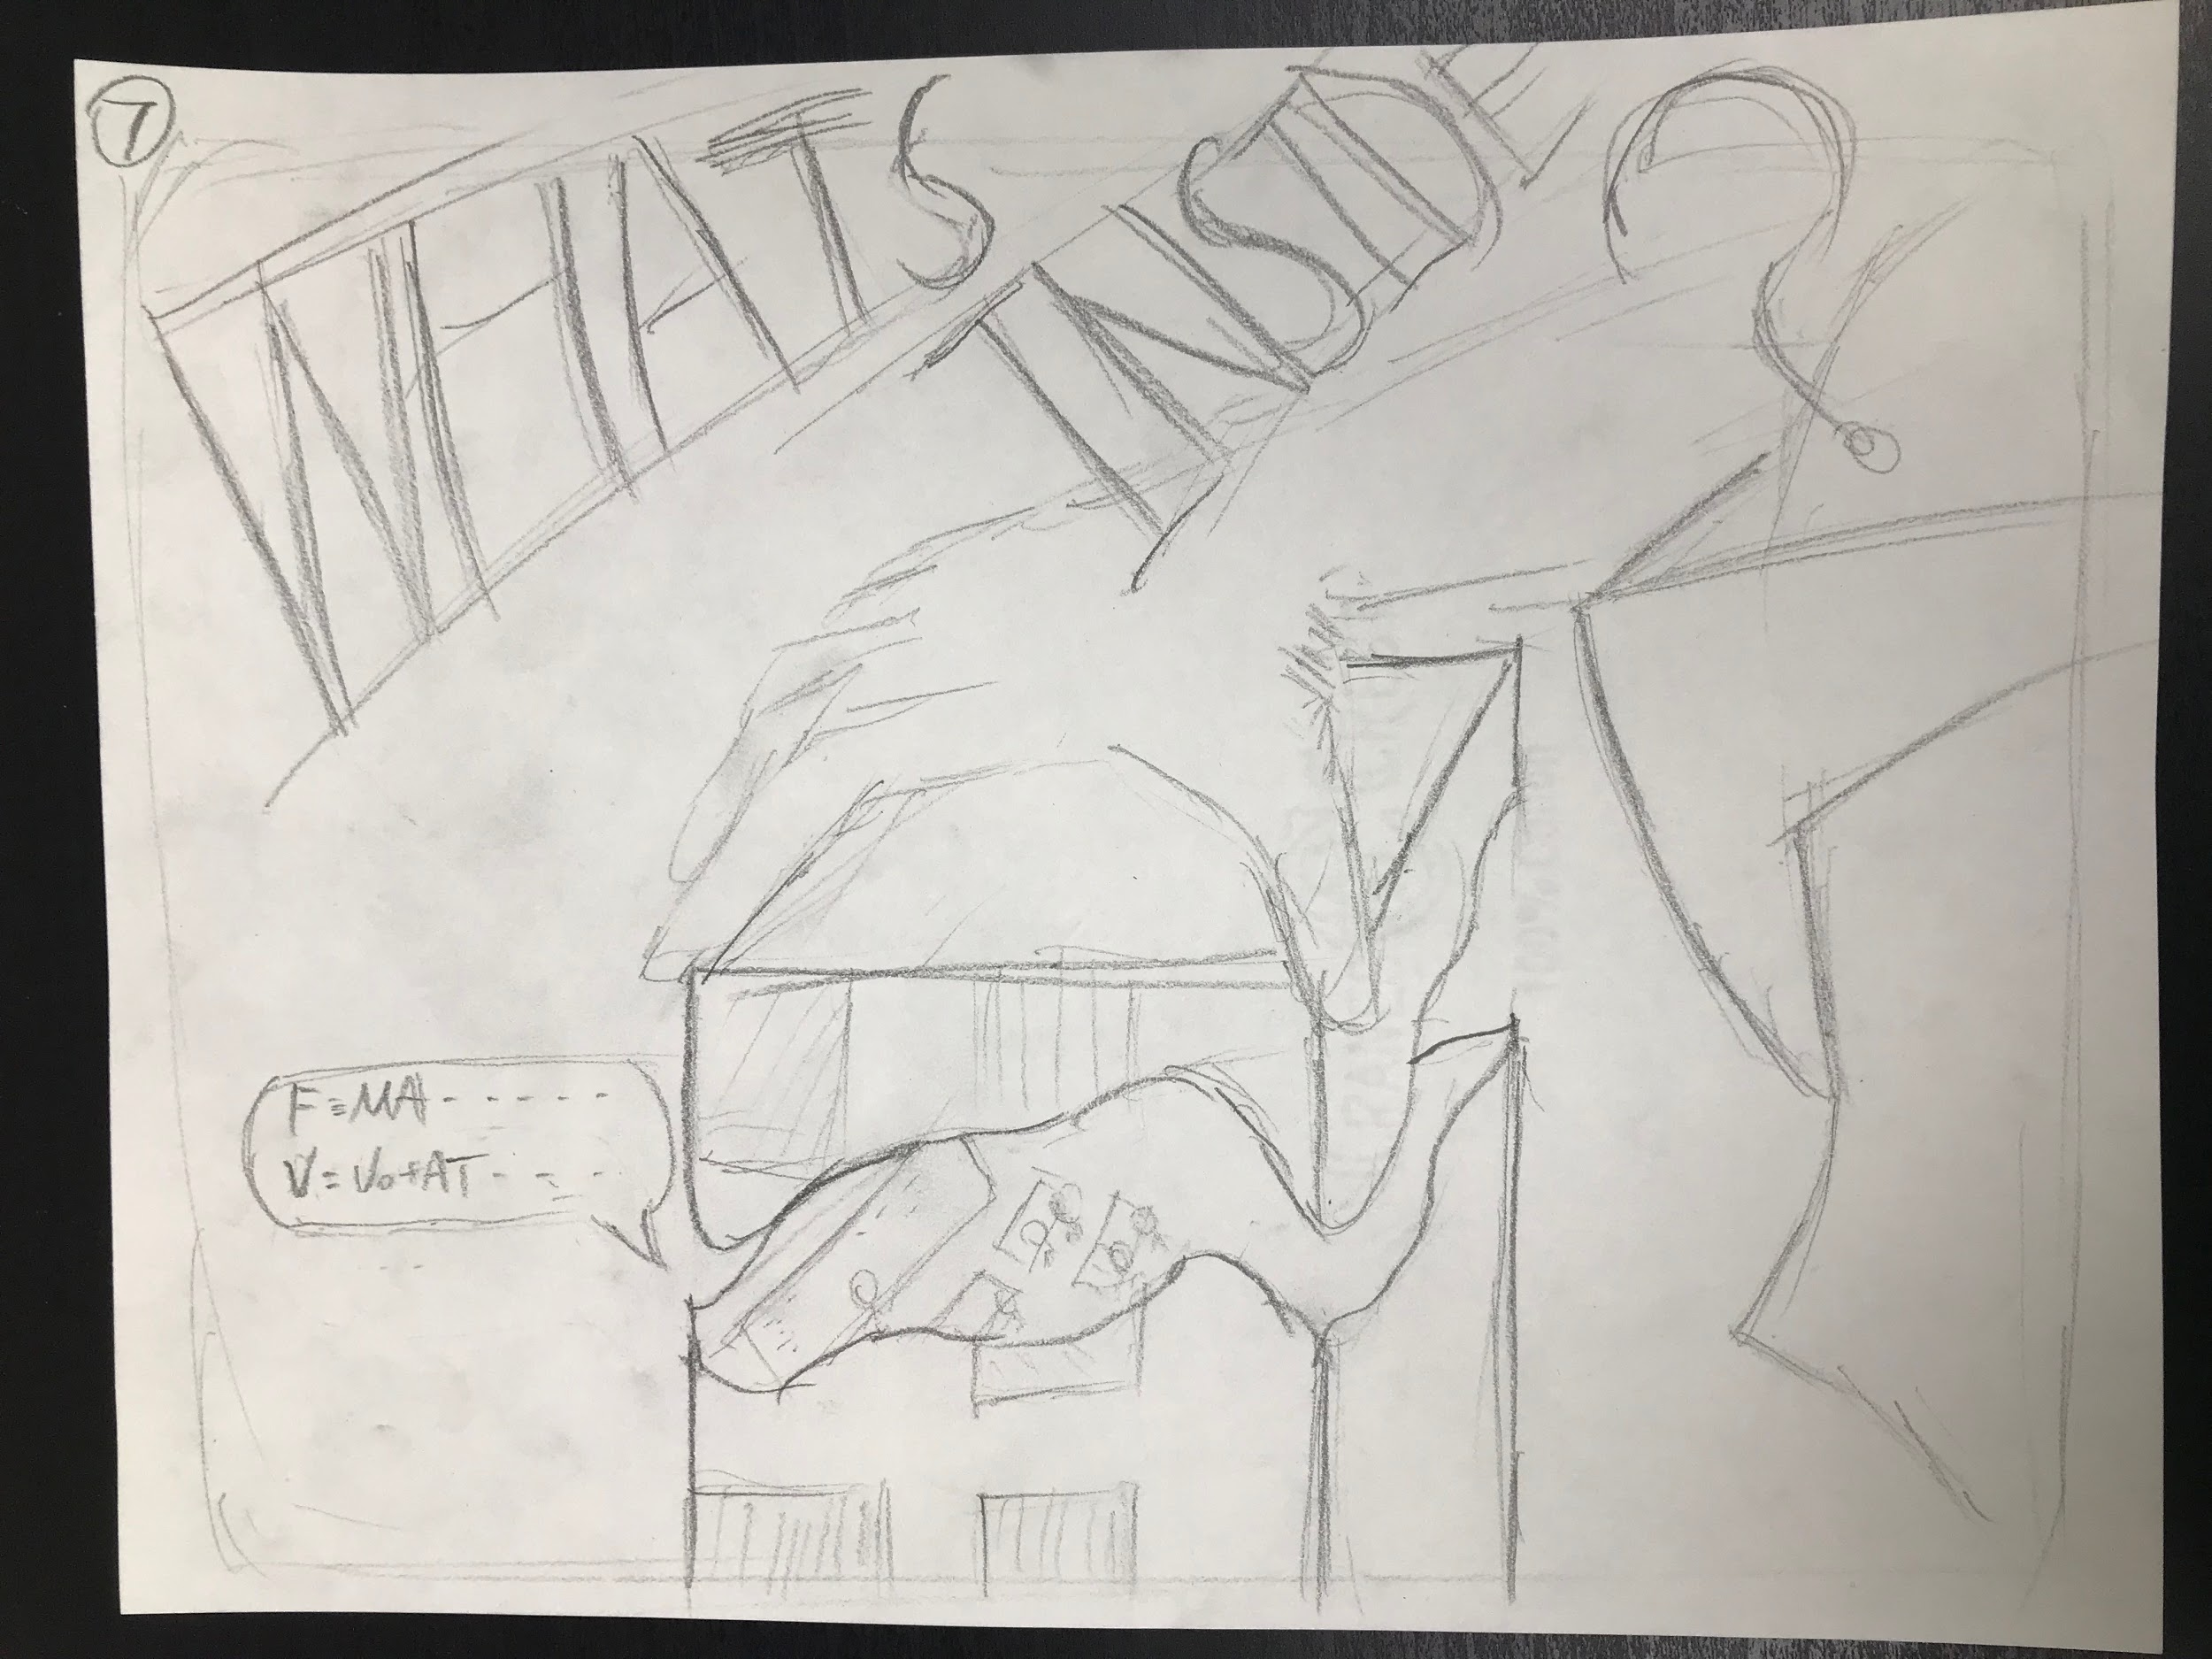
Concept Generation & Early Prototyping

Slide 16
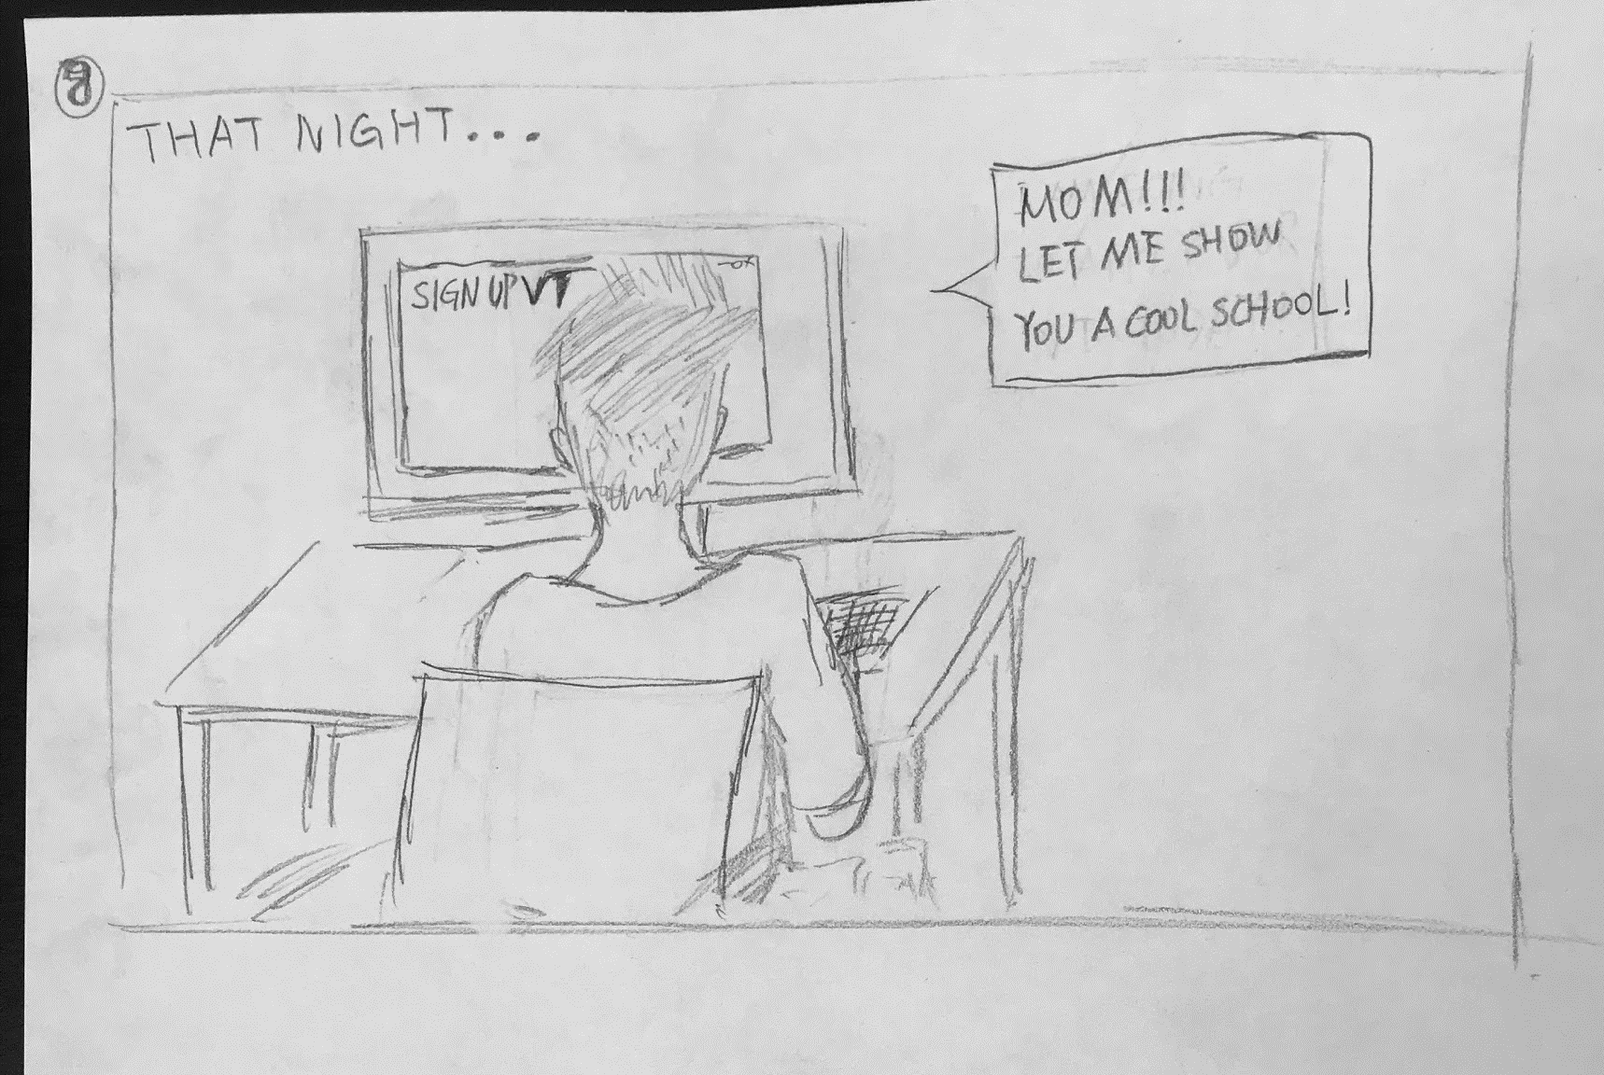
Concept Generation & Early Prototyping

Slide 17
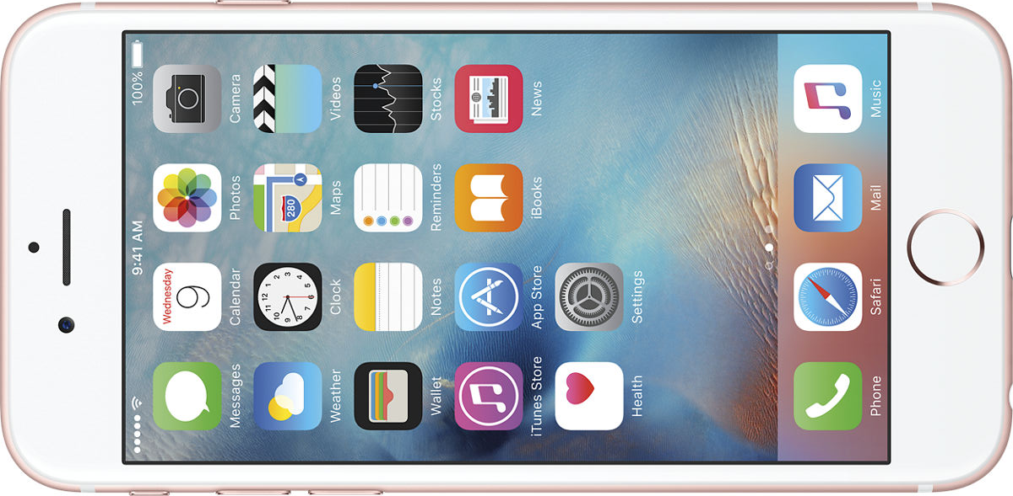
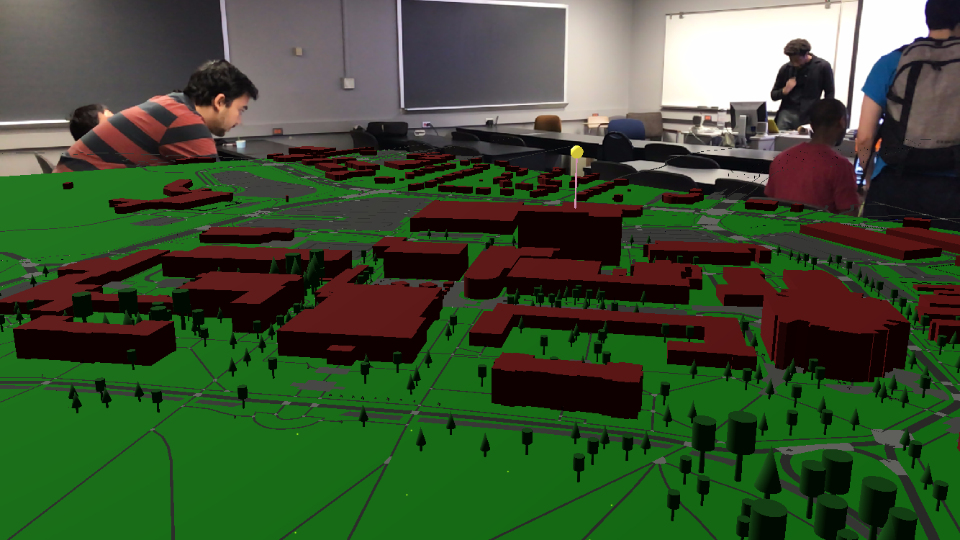
Prototype
Different ideas: a) augmented reality on mobile device
A mobile app with 3D campus
Notes:
A 3D VT campus map for navigation, augmented reality supported, and 360 video player. The first thought is using the ios AR kit to develop an phone based app based on cardboard, but we found the delay of side by side view on cardboard can easily make people dizzee

Slide 18
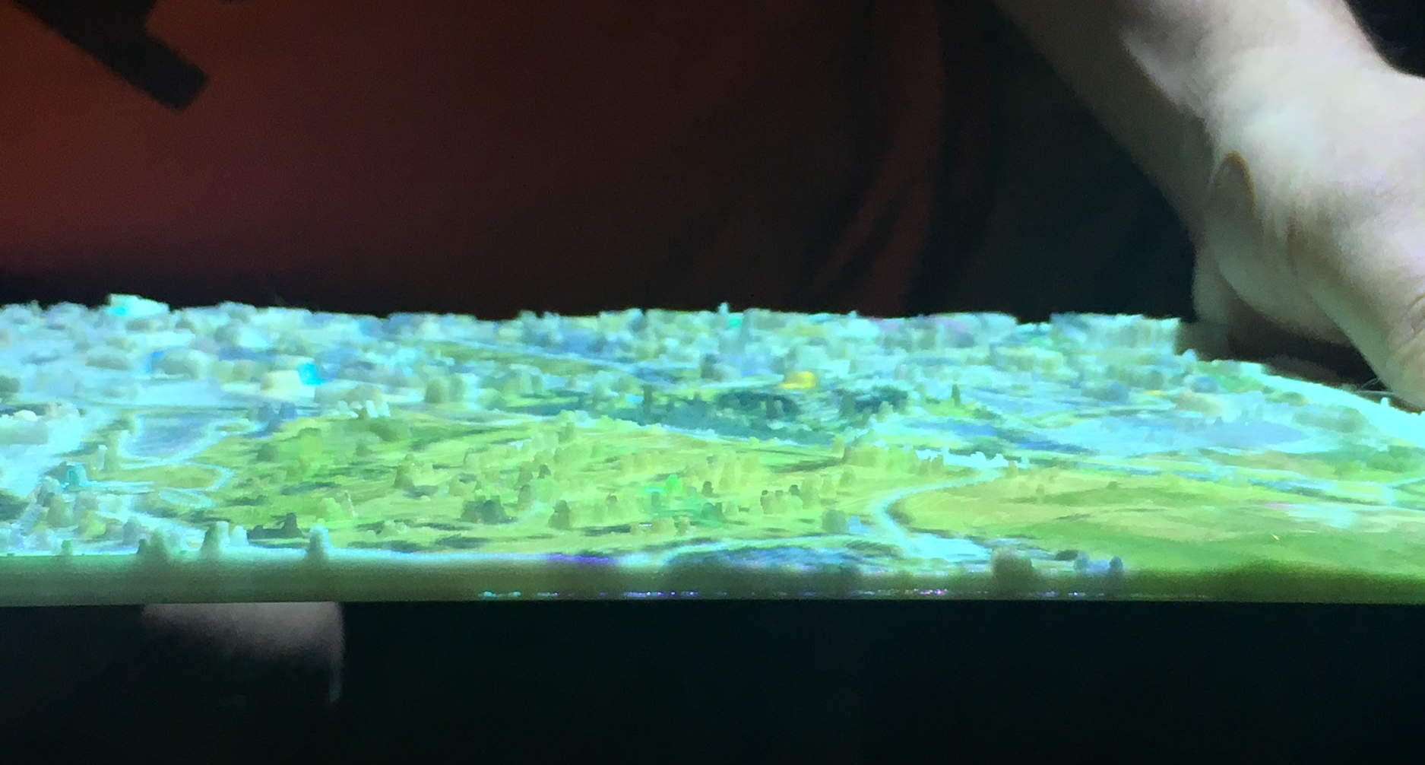
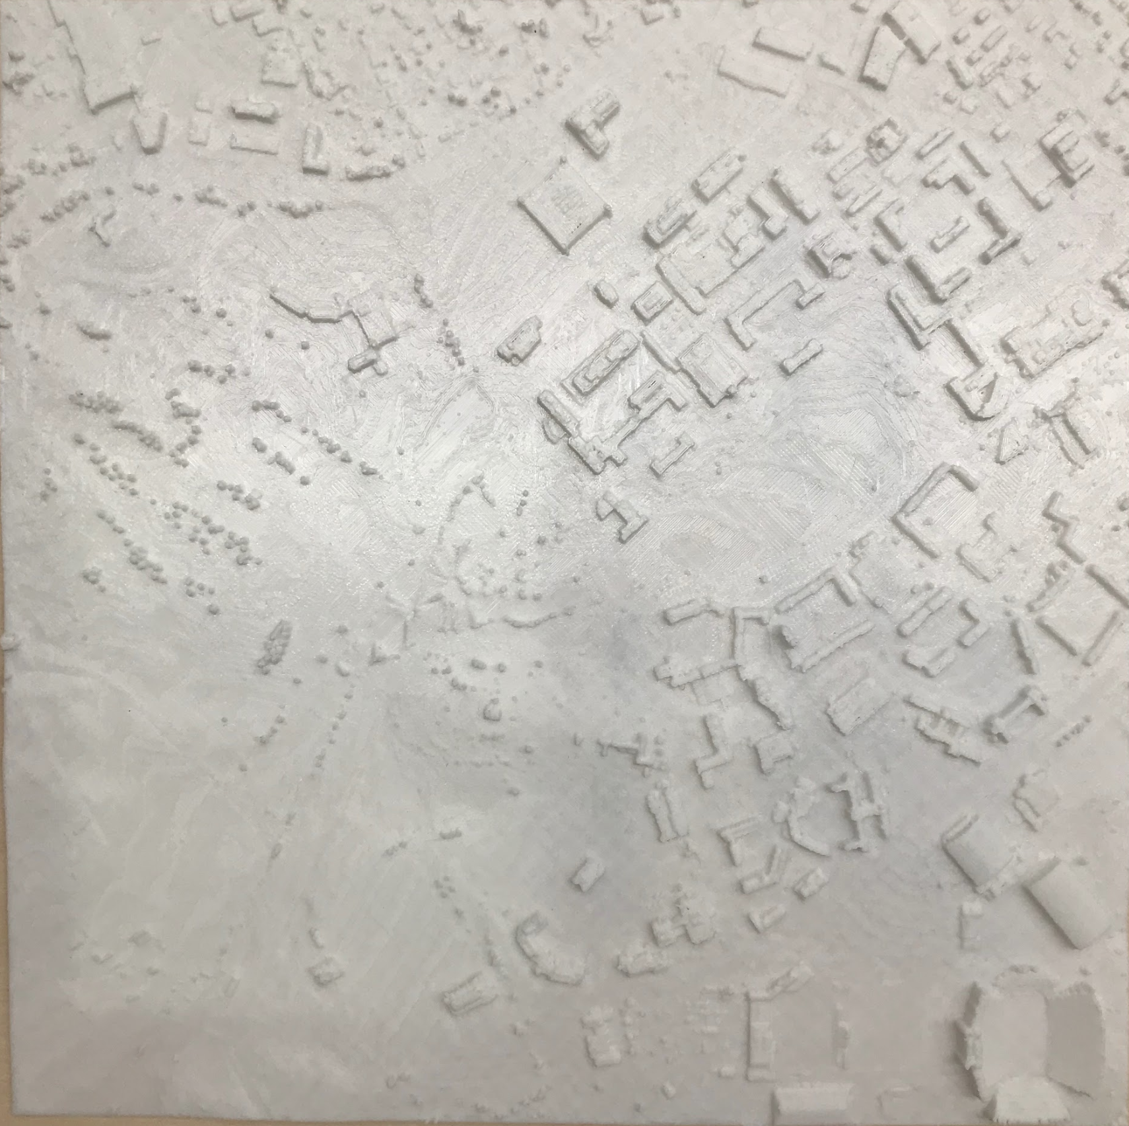
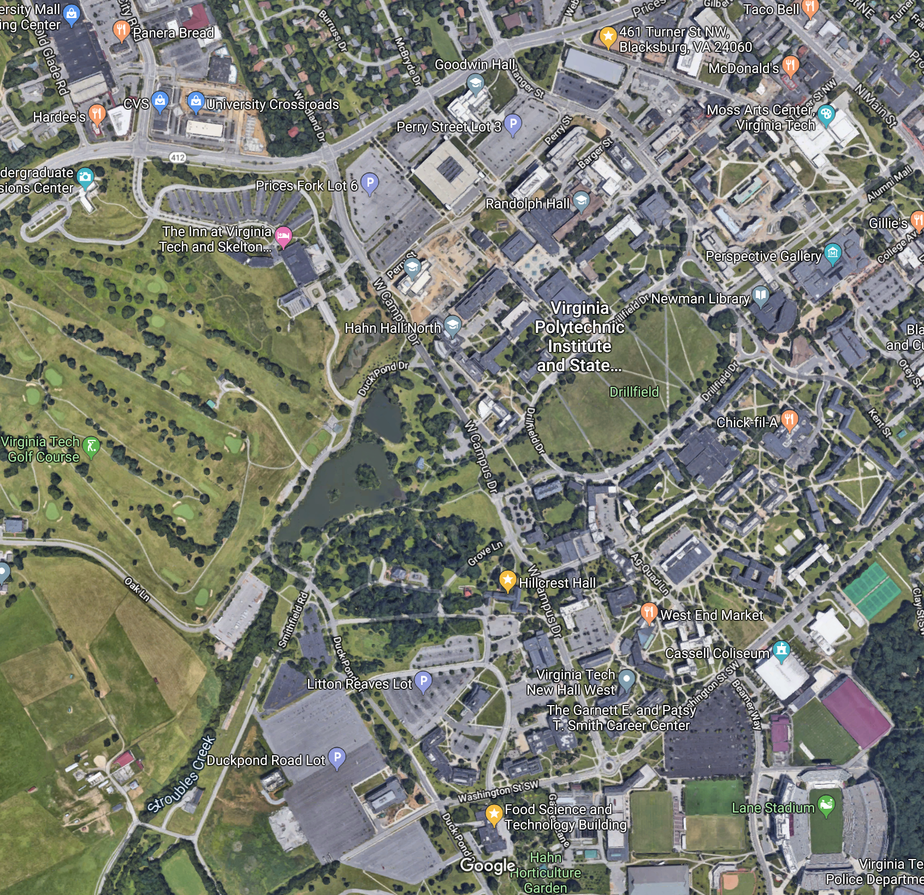
Prototype
Different ideas: b) augmented reality based on 3D projection map
+
=
3D projection map
3D printed map (* from Dr. Sforza)
VT campus map

Slide 19
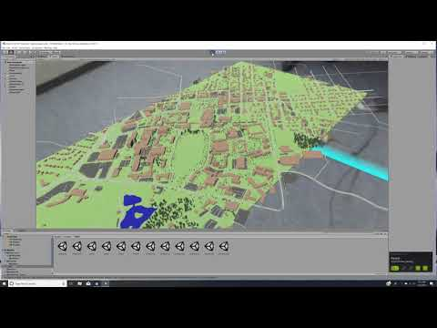
Prototype
Different ideas:
c) simulated AR prototype of VT campus based on see through VR
Features
Navigation
Zoom in/out
Gesture control
Play 360 video/image
* The 360 videos and resource are sponsored by Dr. Gabbard, Dr. Patrick
Notes:
A 3d campus model of virginia tech campus
https://youtu.be/XOXe-Cge1Dk
https://youtu.be/lRBzpBjnWrk

Slide 20
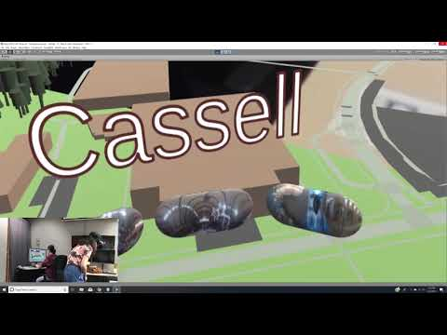
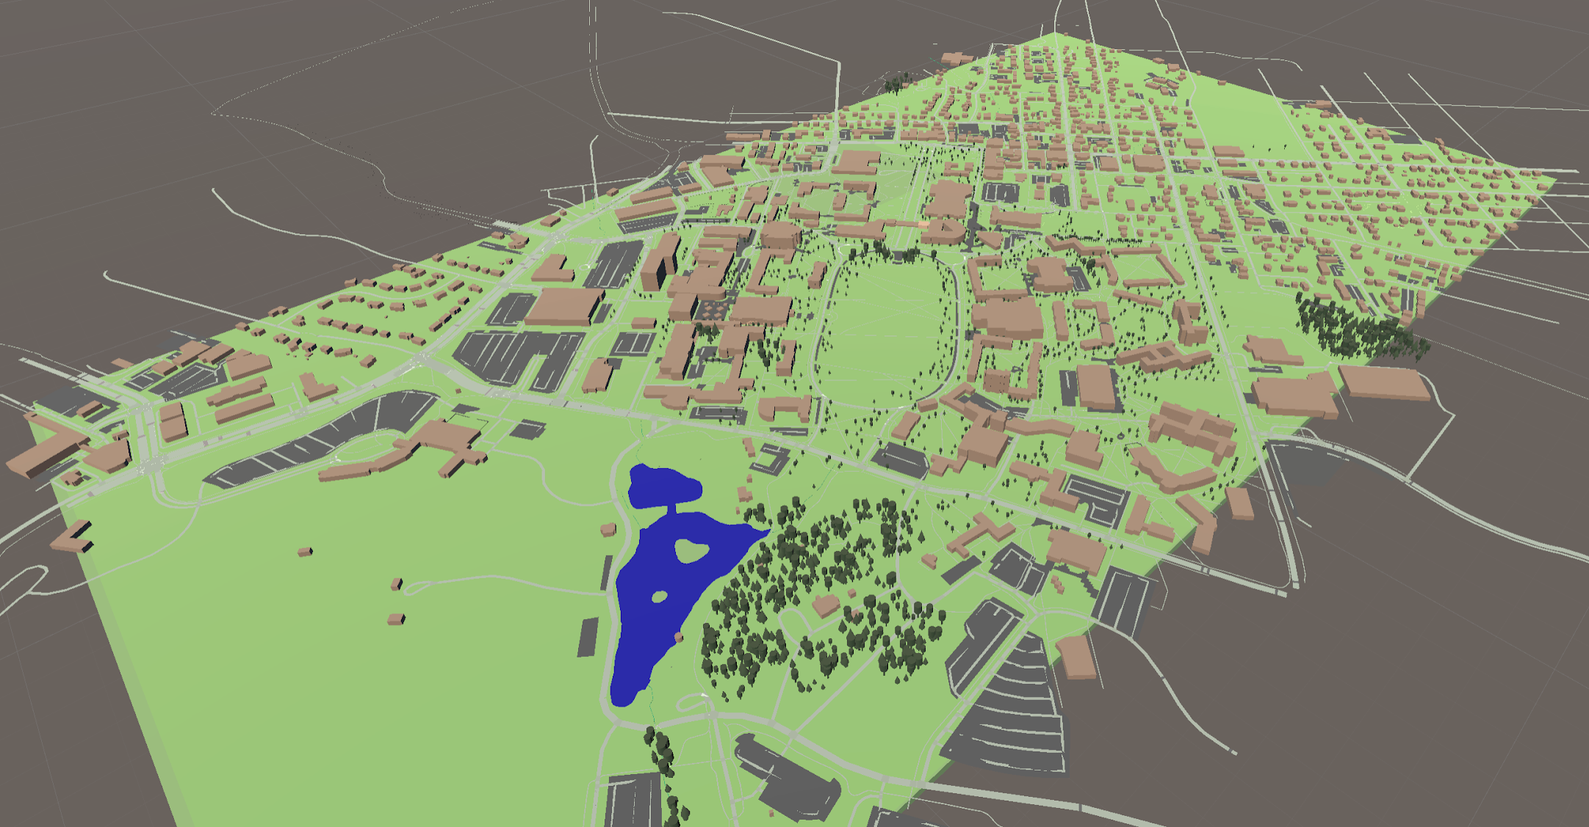
Prototype
Main task:
Locate buildings on campus & play 360 video/image
*The 360 videos and 360 images are sponsored by Dr. Gabbard, Dr. Patrick
Notes:
A 3d campus model of virginia tech campus

Slide 21
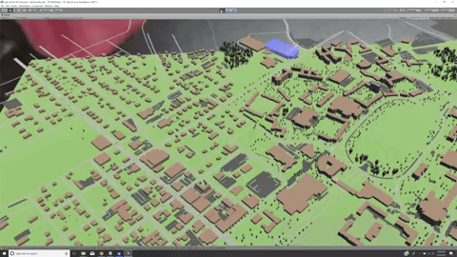
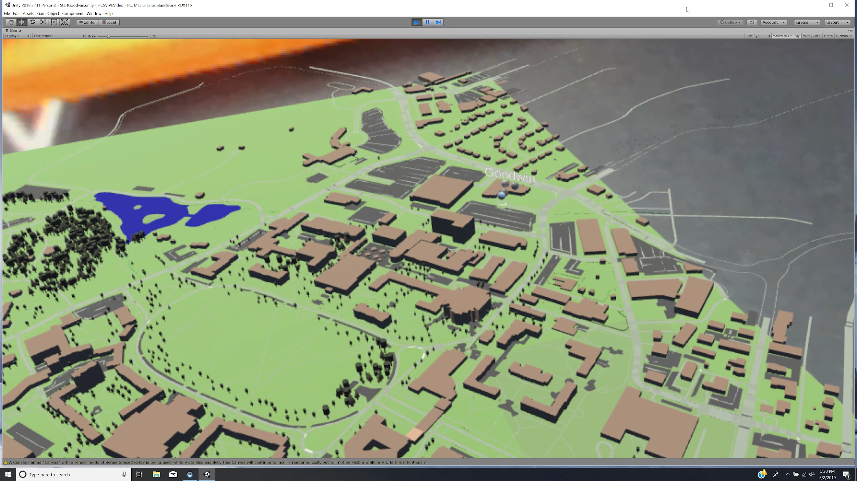
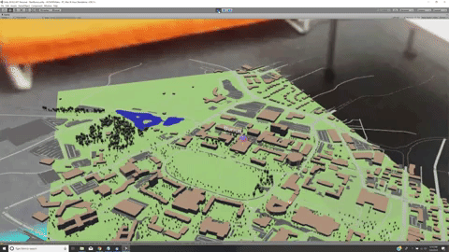
Prototype
Bird’s-eye view of different buildings

Slide 22
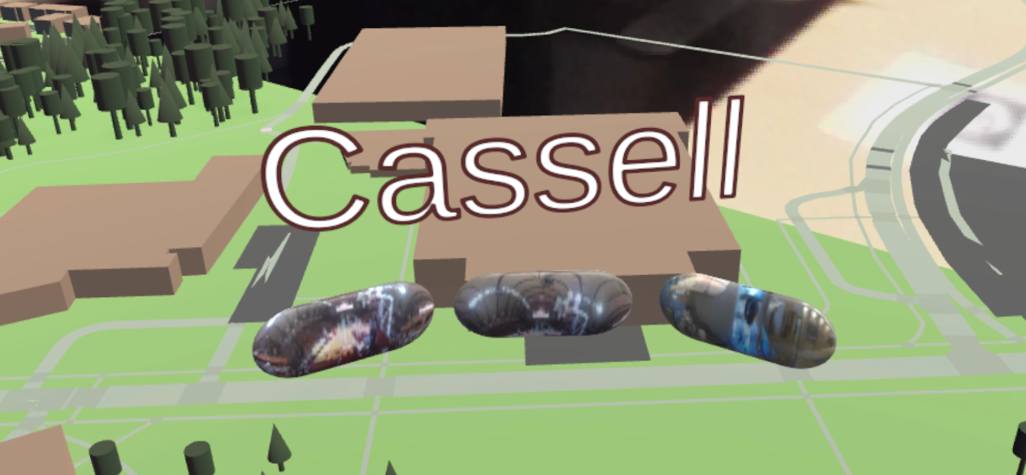
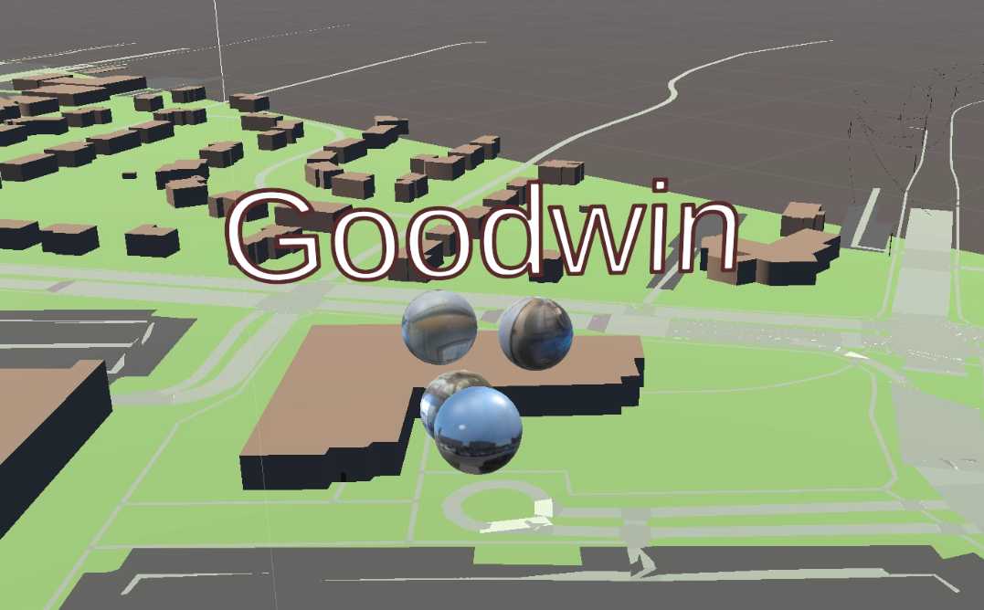
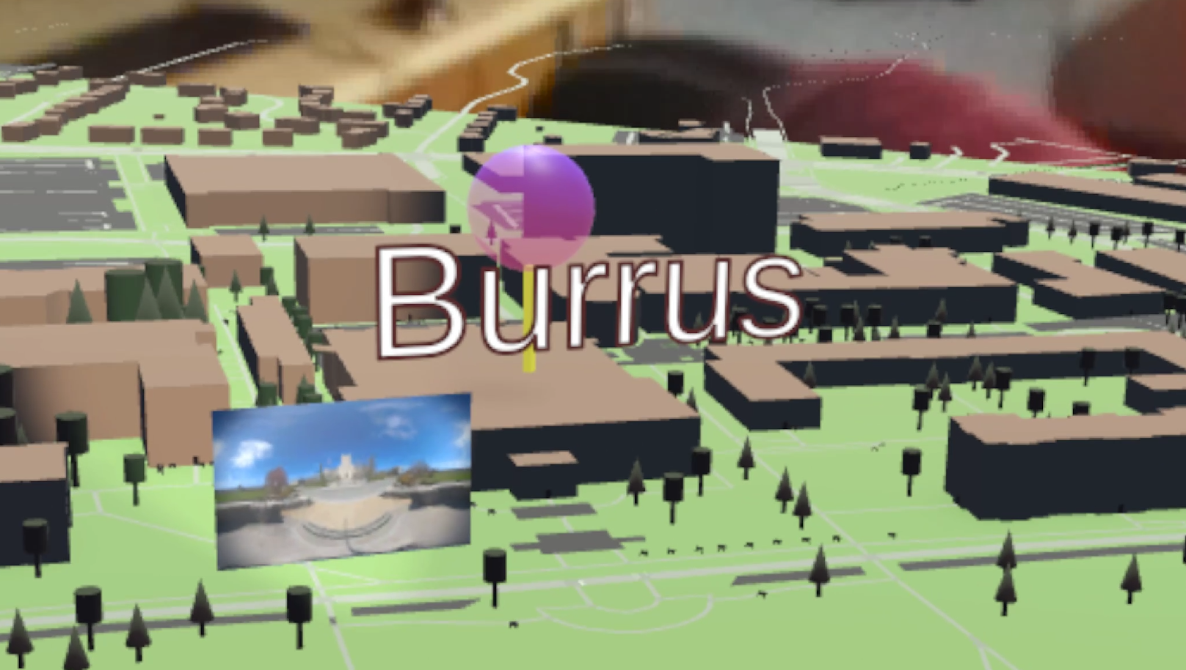
Prototype
Close view for detail interactions

Slide 23
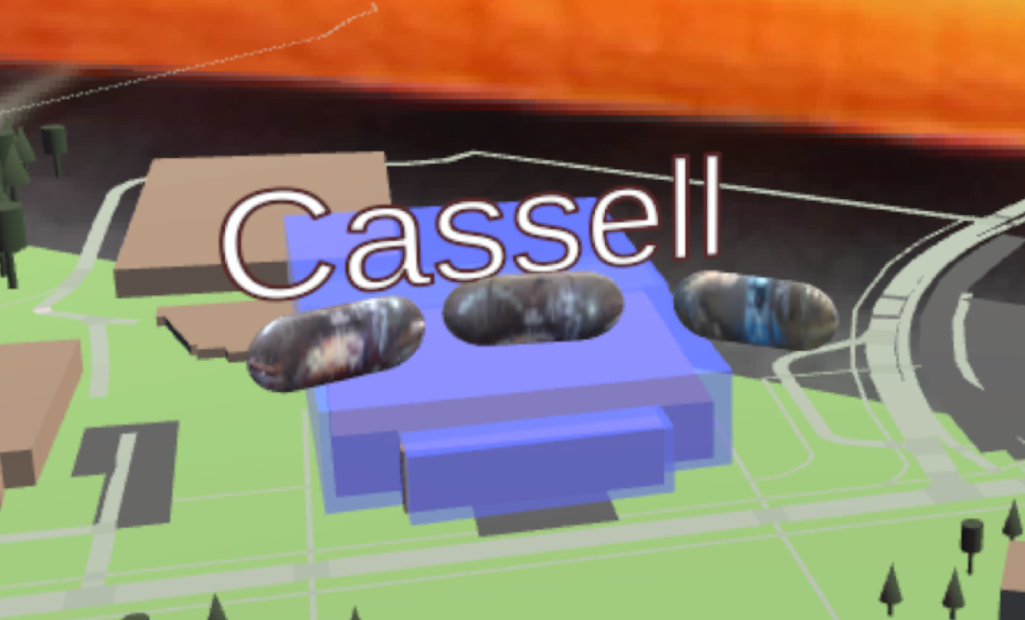
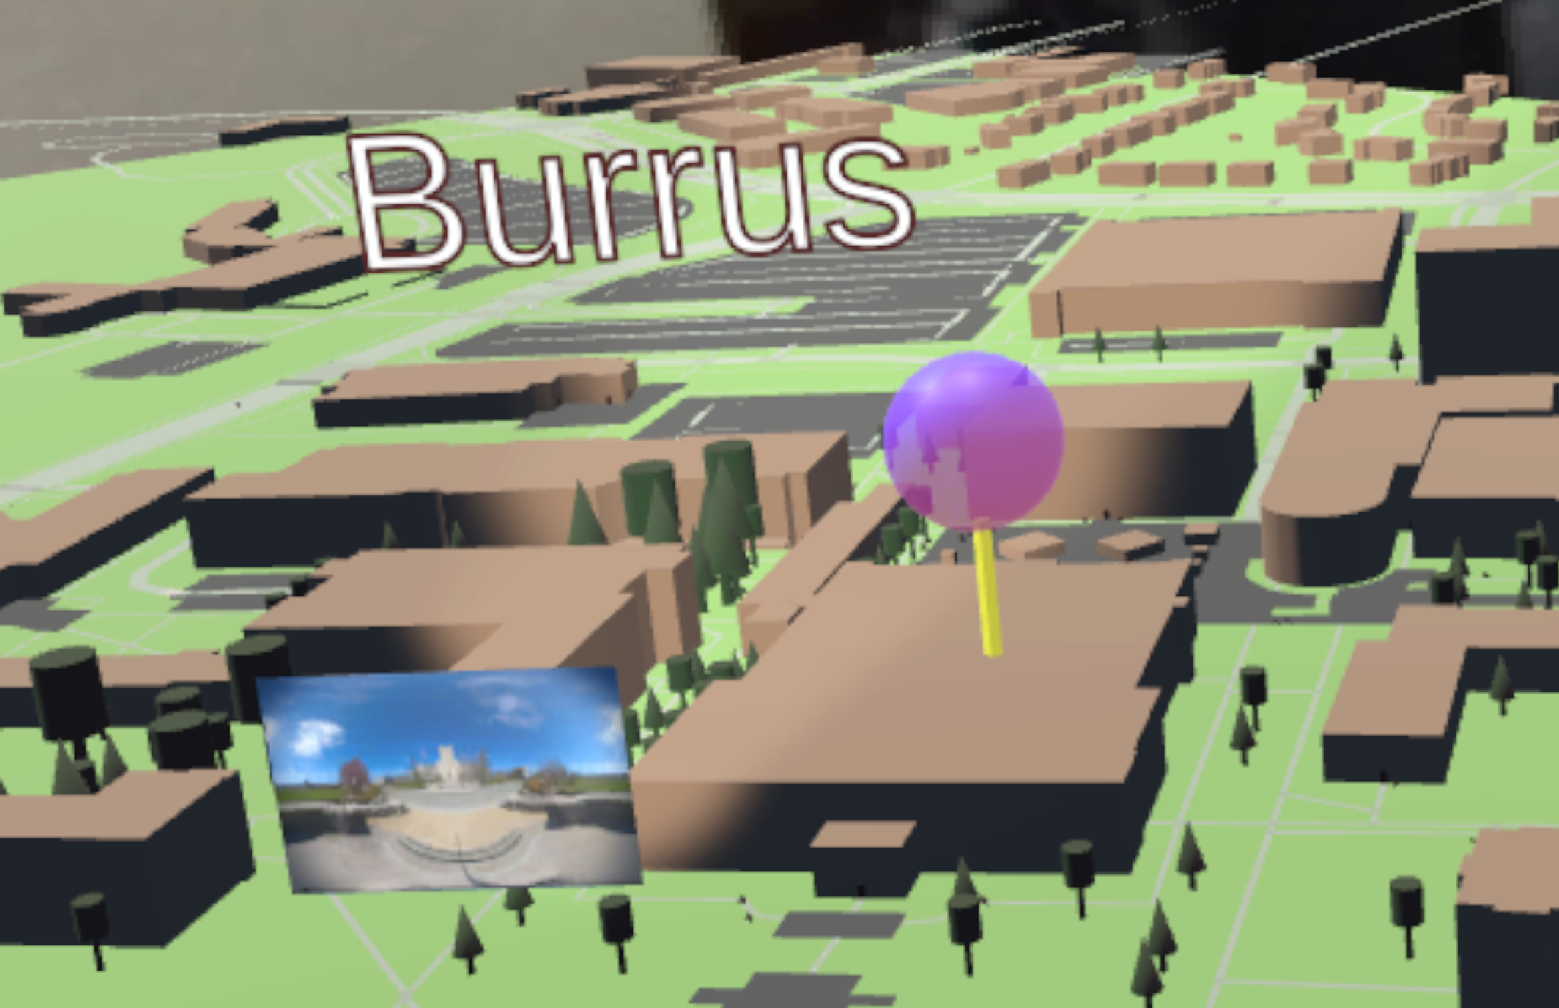
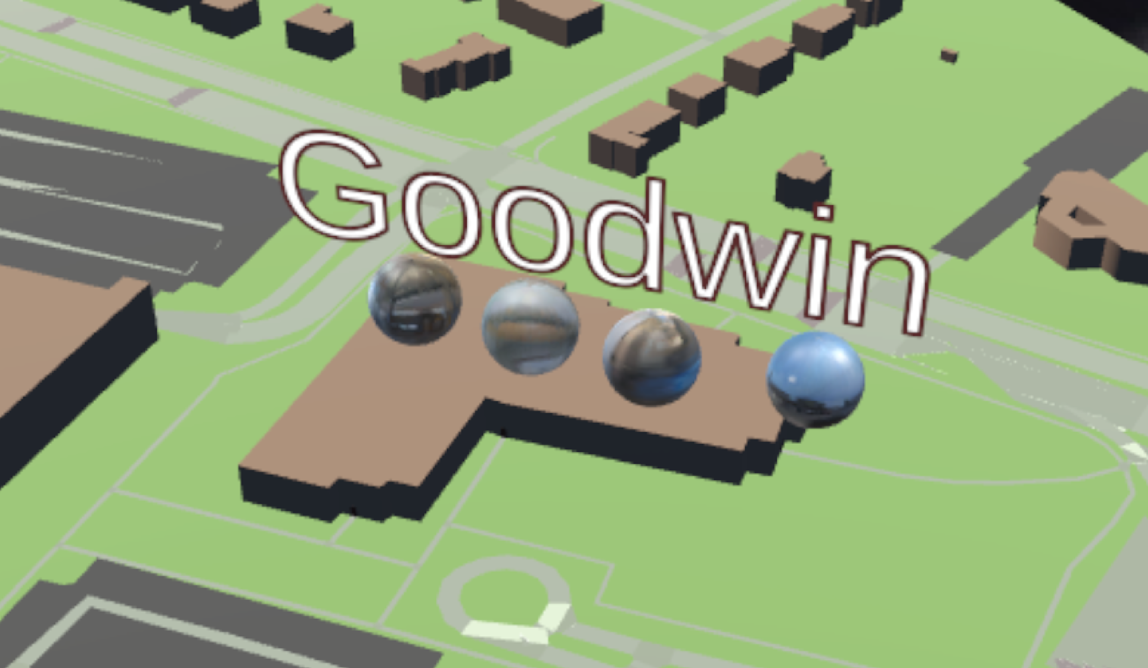
Experiment design and evaluation
Target: Cassell Coliseum
Navigation Cue: Flashing Building
UI: Button
Target: Burruss Hall
Navigation Cue: Target Pin
UI: Billboard
Target: Goodwin Hall
Navigation Cue: Text only
UI: 3D Orbs

Slide 24
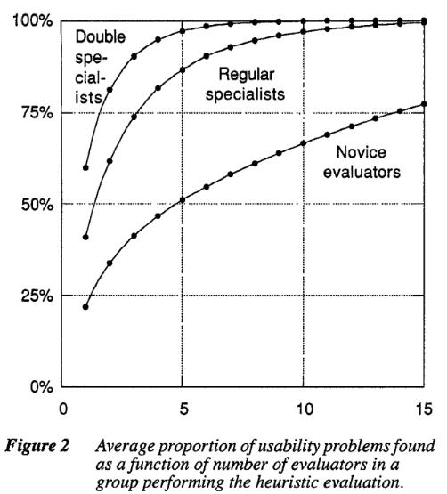
Experiment design and evaluation
Target number of participants:1 (pilot) +4 (main study)
Expertise of participants: Regular-Double specialist
Expected usability issues found: above 80%
Nielsen, J. Finding usability problems through heuristic evaluation. Proc. ACM CHI'92 (Monterey, CA, 3-7 May 1992).

Slide 25
Experiment design and evaluation
Pre Interview
Evaluation
Post Interview

Slide 26
Experiment design and evaluation
Pre Interview
Experience with AR
Feelings toward AR
Experience with gesture control
Brief description of project goal, tasks for evaluation, and backstory for participant character and task
Evaluation
Post Interview

Slide 27
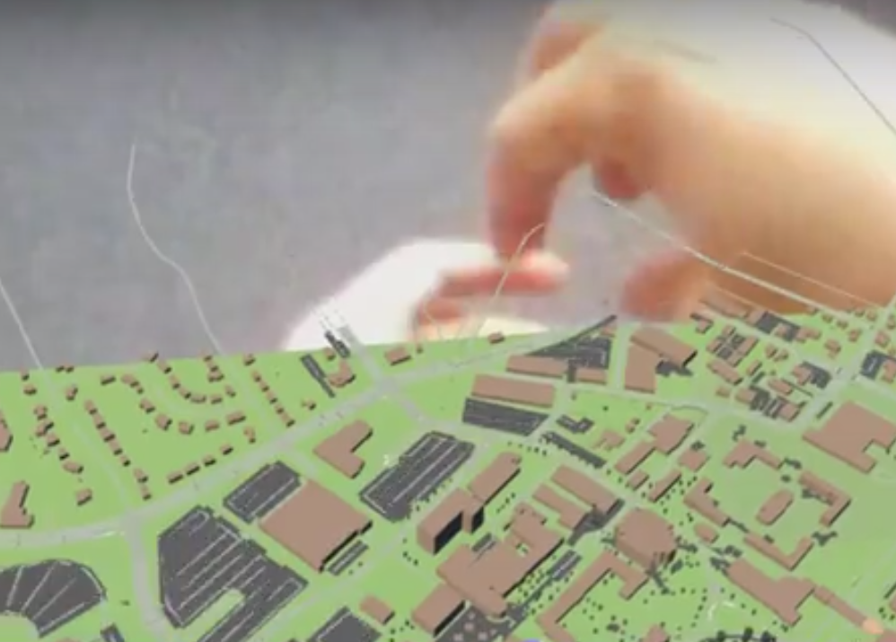
Experiment design and evaluation
Pre Interview
For each target(building)
Find target
Zoom in
Evaluation
Select
Exit
Post Interview
Rest/Interview

Slide 28
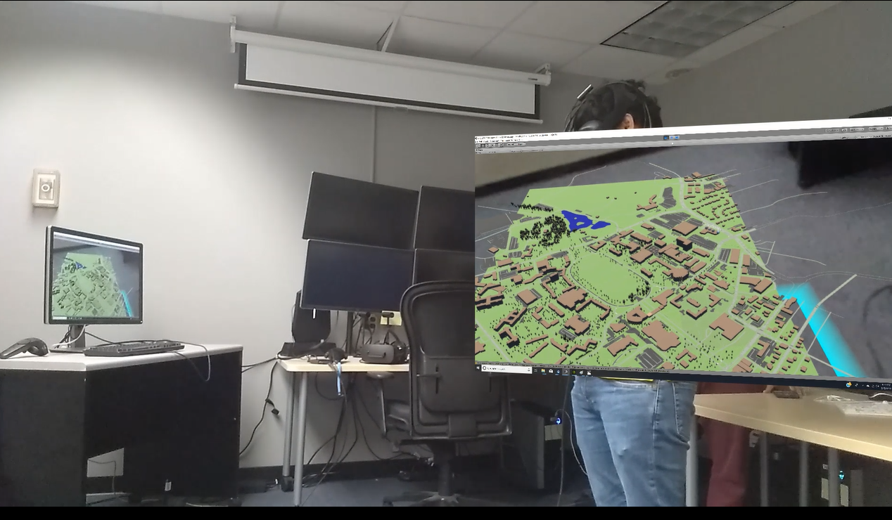
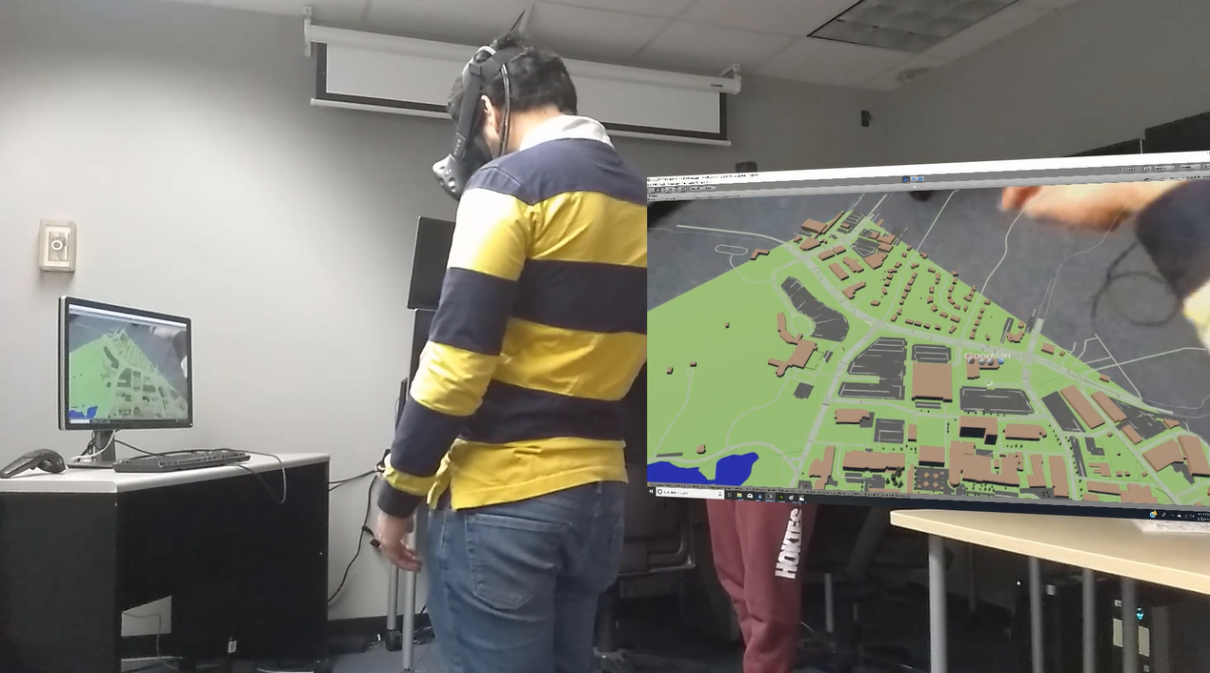
Experiment design and evaluation
Pre Interview
Track time
Find target
Confirm
Evaluation
Post Interview

Slide 29
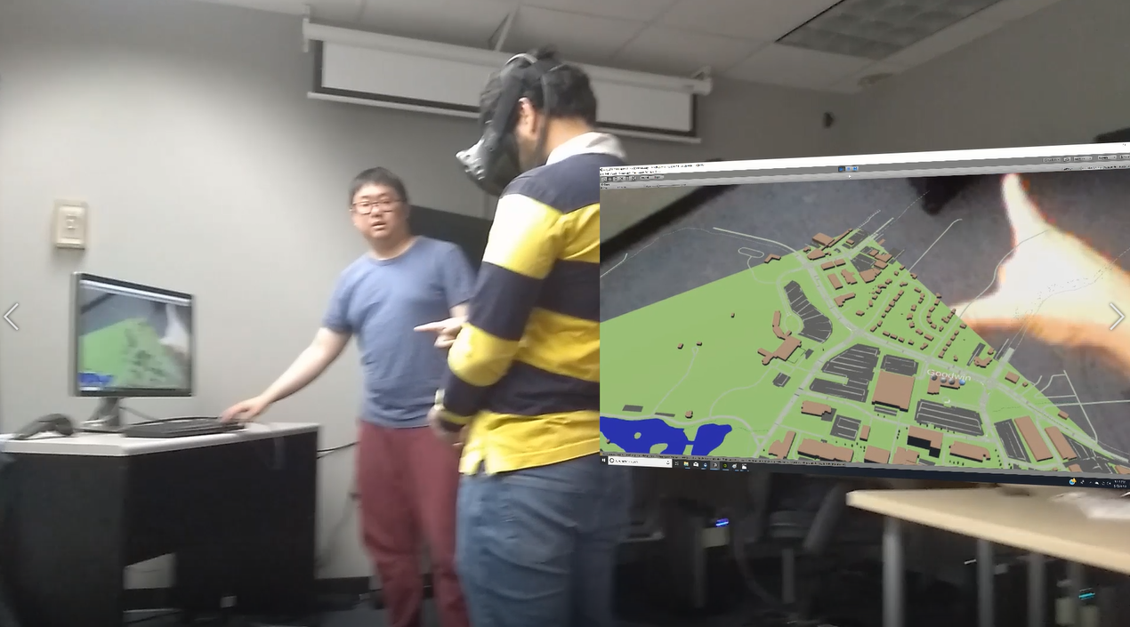
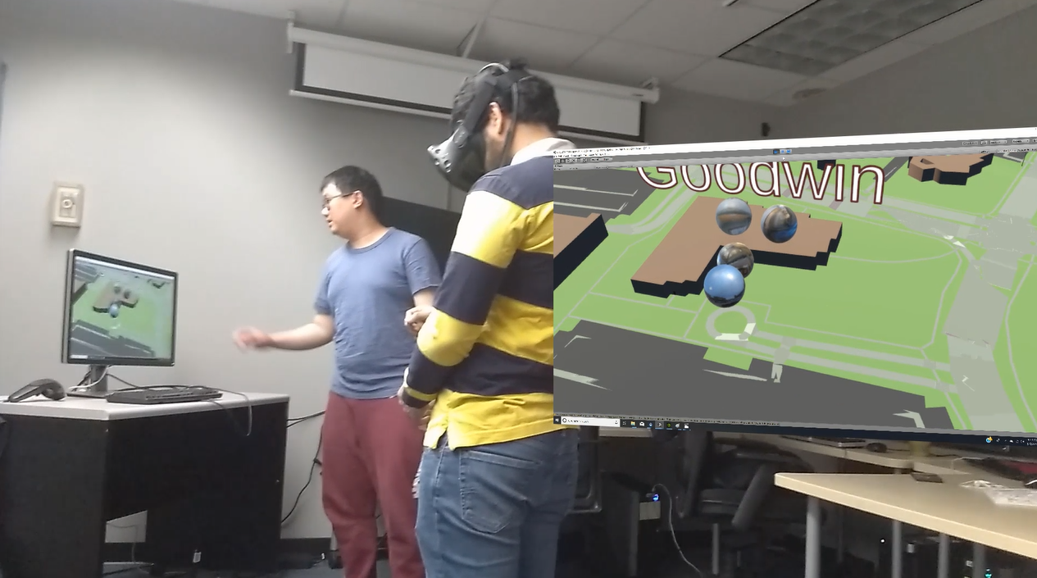
Experiment design and evaluation
Pre Interview
Document gesture(s)
Zoom in
Gesture
Scene Change
Evaluation
Post Interview

Slide 30
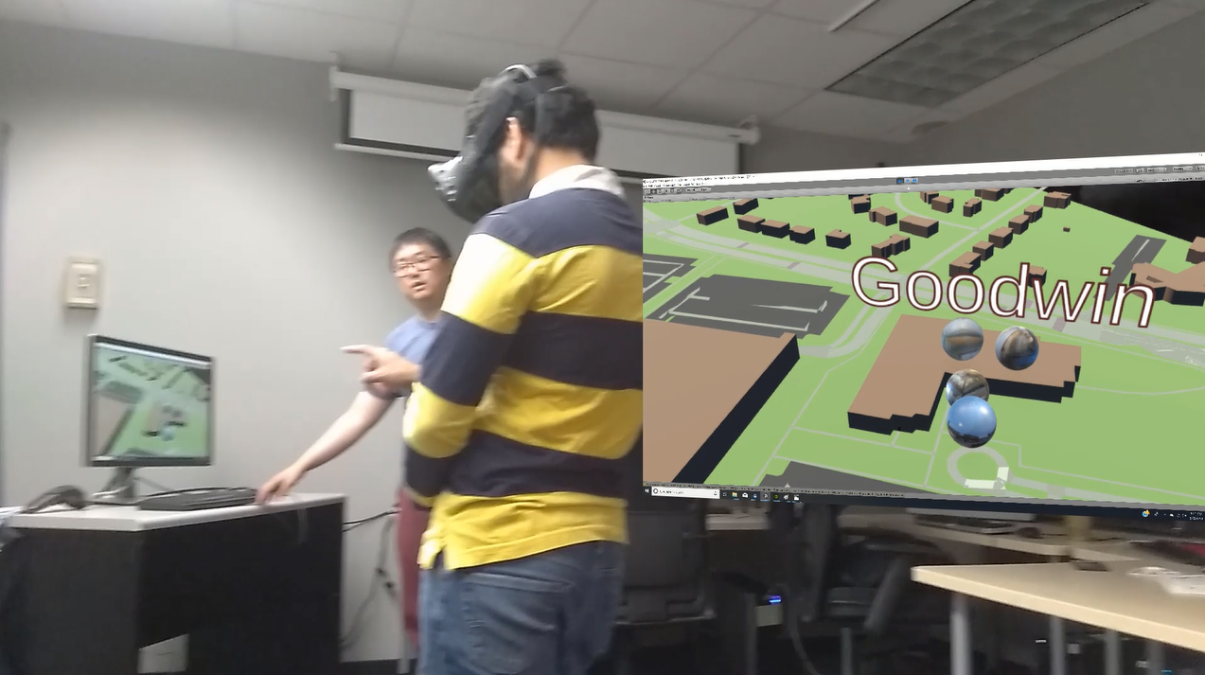
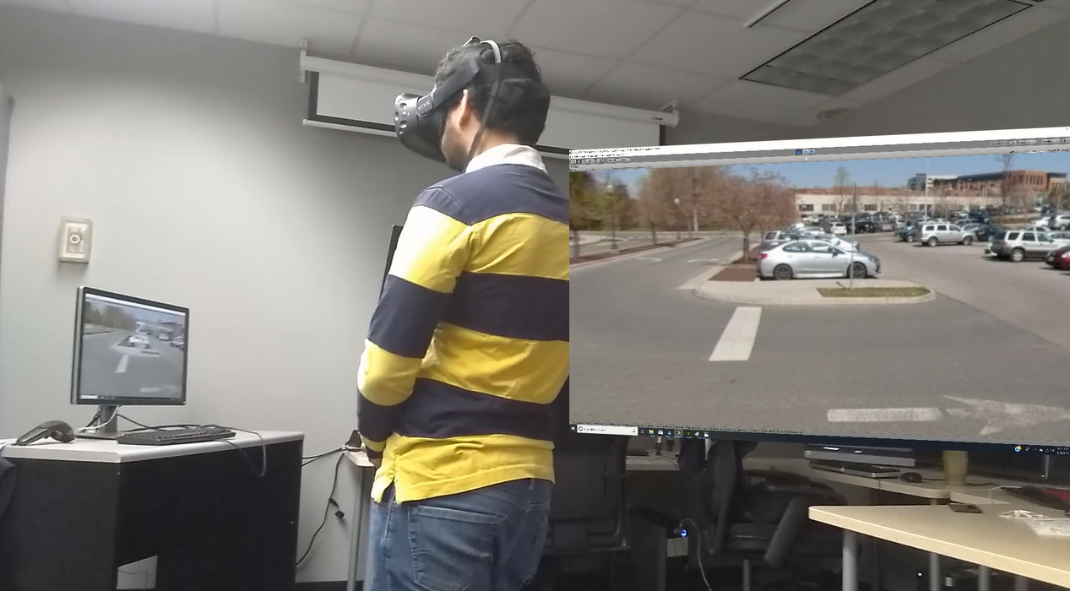
Experiment design and evaluation
Pre Interview
Document gesture(s)
Select
Gesture
Scene Change
Evaluation
Post Interview

Slide 31
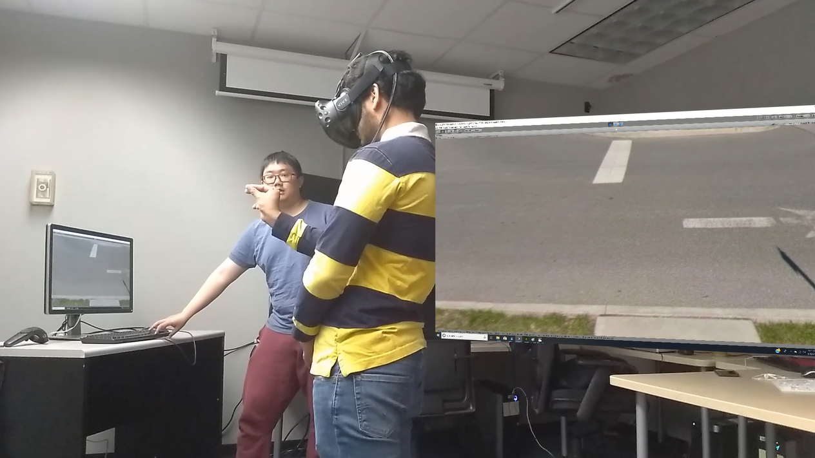
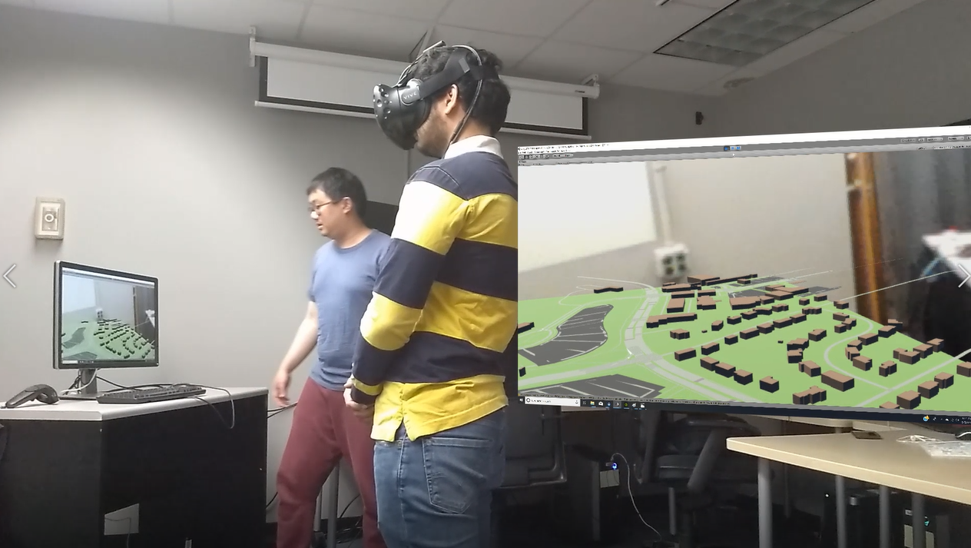
Experiment design and evaluation
Pre Interview
Document gesture(s)
Exit
Gesture
Scene Change
Evaluation
Post Interview

Slide 32
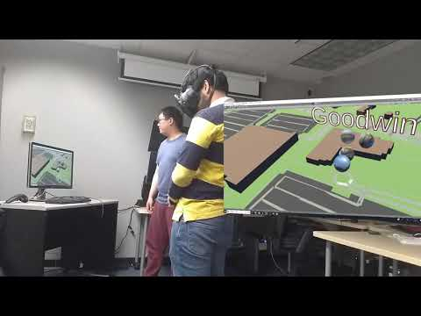
Experiment design and evaluation
Pre Interview
Find target
Zoom in
Evaluation
Select
Exit
Post Interview
Rest/Interview

Slide 33
Experiment design and evaluation
Pre Interview
What is your overall feeling?
What score you will give for the whole experience? 1-10
What you like about the experience?
What you dislike about the experience?
Suggestions for the AR tour?
Evaluation
Post Interview

Slide 34
Result - Pre Interview
AR Experience:
They all have limited AR experience in experiment, tour, and games.
Opinion of AR
-- Interesting & Cool (2)
-- Need to be mature (1)
--Like the experience(2)
Gesture Control Experience:
--No (2)
--Yes (3), experience body control

Slide 35
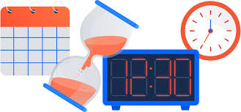
Experiment- Time Tracking
Unit: Sec | P1 | P2 | P3 | P4 | Average
Burruss Hall | 4 | 4 | 17 | 3 | 7
Cassell Coliseum | 4 | 17 | 11 | 12 | 11
Goodwin Hall | 5 | 6 | 14 | 16 | 10.25
Notes:
Burruss hall: target pin and billboard
Cassell: Flashing building and button
Goodwin: Text and 3D orbs

Slide 36
Experiment- Gesture performance- Zoom in
 | P1 | P2 | P3 | P4
Burruss Hall | One hand, two fingers pinch out as using smart phone | Tap | Two hands with fingers close together and pinch out | One hand, two fingers pinch out as using smart phone
Cassell Coliseum | One hand, two fingers pinch out as using smart phone | Tap | Two hands with fingers close together and pinch out | One hand, two fingers pinch out as using smart phone
Goodwin Hall | One hand, two fingers pinch out as using smart phone | Tap | Touch | One hand, two fingers pinch out as using smart phone

Slide 37
Experiment- Gesture performance- Select
 | P1 | P2 | P3 | P4
Burruss Hall | Click | Tap | Touch | Grab
Cassell Coliseum | Click | Tap | Touch | Pinch out more or click
Goodwin Hall | Click | Tap | Grab-pull-lift-click | Pinch out more or click
Notes:
Because the UI, they would Intuitively to grab the pin or the 3D orbs since they are basically balls. Some of them also want to pinch out and zoom in further to select the building.

Slide 38
Experiment- Gesture performance- Exit
 | P1 | P2 | P3 | P4
Burruss Hall | An ‘X’ gestures by two index fingers | Point to the sky | Raise hand | Grab and pull
Cassell Coliseum | One hand, two fingers pinch in as on smartphone | Point to the roof | Raise hand | One hand, two fingers pinch in as on smartphone
Goodwin Hall | An ‘X’ gestures by two index fingers | Point to the window | Tap on ‘exit’ of the scene | One hand, two fingers pinch in as on smartphone
Notes:
For the exit gesture, it really varies. Everybody had different gesture when they want to exit the scene. They used gesture such as…….We also found that when we said choose a gesture to exit the scene, their first reaction was to find a real ‘exit’ like a door or window. We think that is because they were in a 360 image or video so their first reaction is to find a real object

Slide 39
Conclusion- Gesture Control
Target: Cassell Coliseum
Navigation Cue: Flashing Building
UI: Button
Target: Burruss Hall
Navigation Cue: Target Pin
UI: Billboard
Target: Goodwin Hall
Navigation Cue: Text only
UI: 3D Orbs
Notes:
Because of the different UI, they might have different reaction. And their gestures were basically consistent, so the gestures they used in the experiment also depends on the order of the navigation tasks.

Slide 40
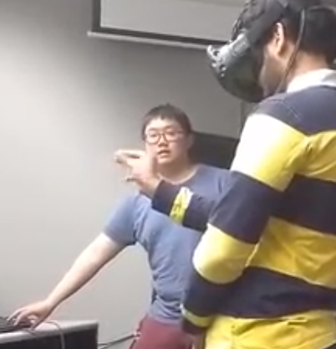
Conclusion- Gesture Control
Zoom in: Pinch out, tap
Select: Click
Zoom out: Vary
It also depends on navigation cue:
Billboard + Target pin
Button + Flashing building
3D orbs + Text only
Different signs can lead to different gestures. People prefer glowing objects.
Notes:
Interaction: some like the button and billboard while some other prefer the target pin. Flashing building and the glowing target pin can help people to find the target building. But for goodwin hall, it only has text and people found it was hard for them to locate the target. And billboard, button can easily help them know that they should click it.

Slide 41
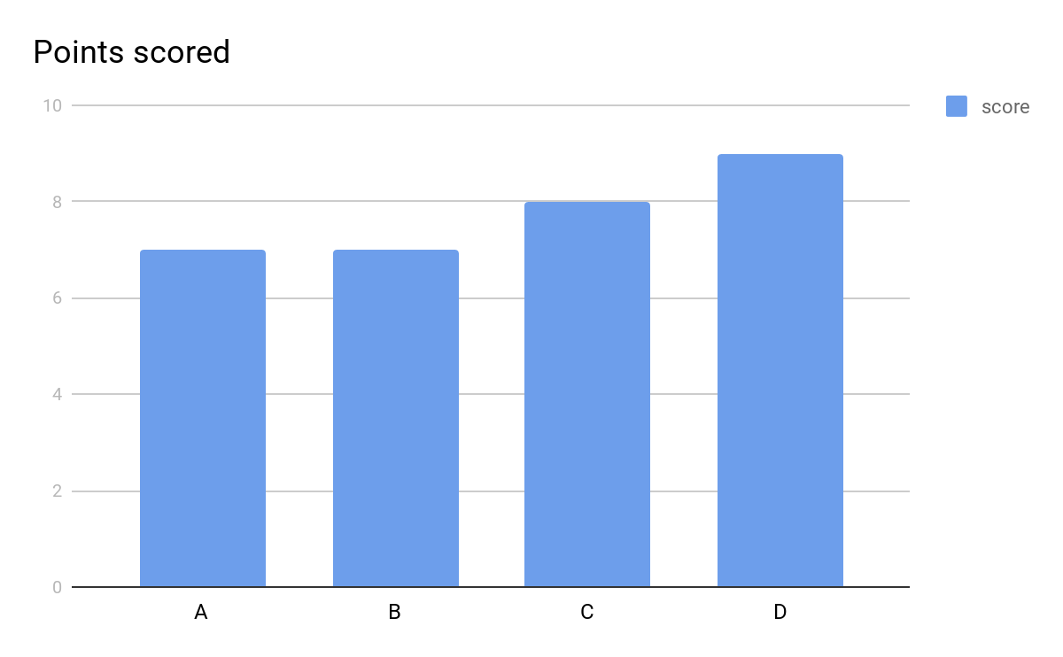
Conclusion- AR Tour experience
Notes:
We also asked them overall feeling and gave us a score out of 10. We received two 7,one 8 and 9

Slide 42
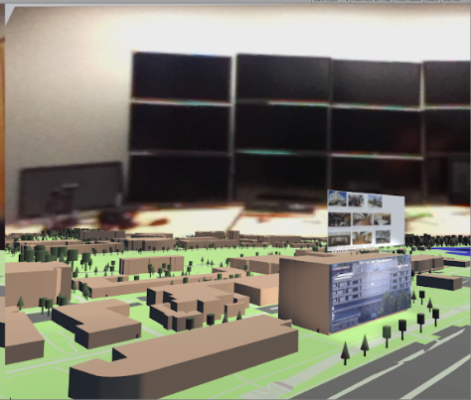
Future Improvement
Build up an interface/menu to help users
Image icon can help interaction (eg. Exit)
Text only cannot help, users prefer to have board/button/pin UI.
Need to consider how to use gesture to exit the 360 image/video.
Order of the UI may influence the decision of gesture control.
The map is too bright
Only change one condition each time
Consider sitting situation
Notes:
For the future improvement, the users mentioned that it is better to have…..Have icon to help them… Exit gesture….During the experiment,.... One of the users thought the map was too bright… During the pilot study, we also received suggestions that …..

Slide 43
Conclusion
Most users found this AR experience useful
This interface can be useful in getting high school students interested in VT within a short period of time
The content of this design can be flexible, ranging from 360 scenes/videos to traditional media similar to handouts/brochures
It is engaging, and unique
Notes:
For the future improvement, the users mentioned that it is better to have…..Have icon to help them… Exit gesture….During the experiment,.... One of the users thought the map was too bright… During the pilot study, we also received suggestions that …..

Slide 44

Thank you!

